Slide 1


News Mavens
Team Members:
Usama Shafique(SE 7-Semester -UET40)
Rameen Naveed(E 7-Semester -UET42)
Asjad Ullah(E 7-Semester -UET31)

Slide 2
Basic Idea / Problem Statement
What Problem or Need are you Addressing ?
Job security is one of the most challenging aspects of being a journalist nowadays[1].
Also media houses can't find the right person because of the market gap[2].
People nowadays rely on social media news that isn't authenticated and doesn't have a reliable source
[3].
There isn’t a proper channel for hiring journalist for single project remotely or on-site.[4]

Slide 3
Basic Idea / Problem Statement
Briefly present the main points of business idea
To assist the journalist community in finding freelance remote work opportunities and to reduce job insecurity for journalists.
To assist media outlets, news channels, and online newspaper companies in finding the best journalists for their needs.
It assists in keeping everyone up to date on news reports by providing authentic and useful news.

Slide 4
Product / Solution
How are you Solving this Problem or Need?
To Help the Journalists community to find freelance remote work opportunities and to reduce the Job insecurity for journalists.
To help the Media houses, News channels, and online newspaper companies to find the best journalist they need.
To keep everyone up to date about daily news reports that are authentic and resourceful news.

Slide 5
Product / Solution
Briefly present the points for your proposed work.
Also, our platform will help users to get every kind of news just a single tap away in form of a mobile application.
Our platform will make sure to provide both ends journalists, news agencies and organization to have a better way of communication

Slide 6
Social & Creative Impact
Explore the Social and/or Creative Impact of your work
In our society job security is one of the most challenging aspects of being a journalist nowadays .Our platform Reduce the Job insecurity for journalists.
There is a communication gap in the news industry, and our platform will ensure that both ends, journalists and news agencies, have a better and more modern way of communicating via our platform.

Slide 7
Social & Creative Impact
How the social or Creative Venture will become Sustainable?
Provide journalists with the opportunities, flexibility, and control to work in a way that fits their lifestyle, whether part-time or full-time.
Maintaining high standards of quality and integrity
Activities that promote knowledge, work preparation, job creation, and the development of work infrastructure skills

Slide 8
Why now?
Why do you believe this Product / Solution is required in the Market at this time.
Observe that there is no Platform for journalists.
What could be the loss if this work is not performed now.
If we do not do this right away, we will not be able to minimize the journalist communication gap.

Slide 9
Expected Market for this Idea
What is the total addressable market size.
50,000 jounalists.
How many Lives will be Impacted by your Product / Solution
News industries.
Journalists.
Viewers.
Who are your competitors?
UpWork
Jounalism.com
Contena

Slide 10
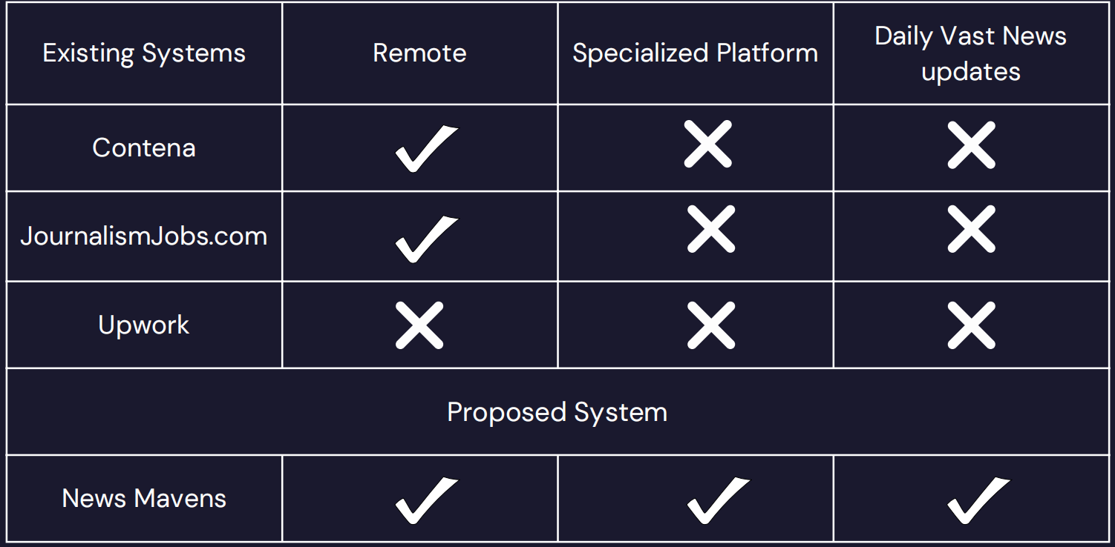
Expected Market for this Idea
How is your Product / Solution different from existing options in the Market

Slide 11
Team
Usama Shafique
Software engineering
Rameen Naveed
Software engineering
Asjad Ullah
Software engineering

Slide 12
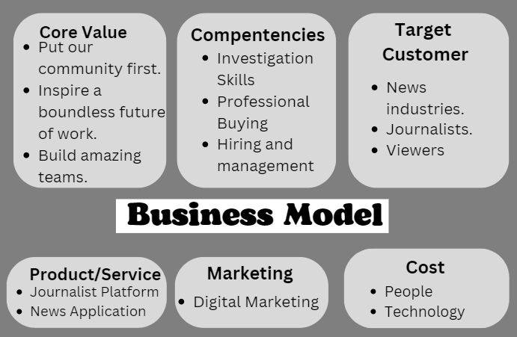
Business Model
Include a figure to present the flow of main components for the business Model

Slide 13
Financial Impact
State the initial funding source for the project .
NPC
RIUJ
Self Funding.
How will you make Money by this idea?
Ads are displayed and monetized in a variety of ways.
CPM - where we are paid for a certain number of ad impressions.
CPV - earnings are determined by the number of views received by our application.

Slide 14
[1].Westlund, O. (2013). Mobile news: A review and model of journalism in an age of mobile media. Digital journalism, 1(1), 6-26. [2].Vandenbroucke, K., Baccarne, B., & Schuurman, D. (2014). Connecting with citizen journalists: an exploratory Living lab study on motivations for using mobile reporting applications. In Etmaal van de communicatiewetenschappen, Proceedings. Wageningen, The Netherlands. [3]. Westlund, O. (2013). Mobile news: A review and model ofjournalism in an age of mobile media. Digital journalism, 1(1), 6-26. [4].Sidiropoulos, E., Vryzas, N., Vrysis, L., Avraam, E., & Dimoulas, C. (2019). Growing media skills and know-how in situ: Technology-enhanced practices and collaborative support in mobile news-reporting. Education Sciences, 9(3), 173.

Slide 15
Thank you

